Slide 1
Process Synchronization

Slide 2
Process Synchronization
In the Operating System, there are a number of processes present in a particular state.
At the same time, we have a limited amount of resources present, so those resources need to be shared among various processes.
But if two processes are using the same resource at the same time this may lead to data inconsistency.
So, synchronization of process should be there in the Operating System.
These processes that are sharing resources between each other are called Cooperative Processes
The processes whose execution does not affect the execution of other processes are called Independent Processes.

Slide 3
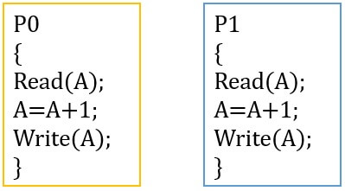
Race Condition
In an Operating System, we have a number of processes and these processes require a number of resources.
Now, think of a situation where we have two processes and these processes are using the same variable "a".
They are reading the variable and then updating the value of the variable and finally writing the data in the memory.
SomeProcess()
{ ...
read(a) //instruction 1
a = a + 5 //instruction 2
write(a) //instruction 3
... }

Slide 4
In the above, you can see that a process after doing some operations will have to read the value of "a", then increment the value of "a" by 5 and at last write the value of "a" in the memory.
Now, we have two processes P1 and P2 that needs to be executed.
Let's take the following two cases and also assume that the value of "a" is 10 initially.
In First case, process P1 will be executed fully (i.e. all the three instructions) and after that, the process P2 will be executed. So, the process P1 will first read the value of "a" to be 10 and then increment the value by 5 and make it to 15. Lastly, this value will be updated in the memory. So, the current value of "a" is 15.
Now, the process P2 will read the value i.e. 15, increment with 5(15+5 = 20) and finally write it to the memory i.e. the new value of "a" is 20. Here, in this case, the final value of "a" is 20.

Slide 5
In second case, let's assume that the process P1 starts executing. So, it reads the value of "a" from the memory and that value is 10(initial value of "a" is taken to be 10). Now, at this time, context switching happens between process P1 and P2.
Now, P2 will be in the running state and P1 will be in the waiting state and the context of the P1 process will be saved. As the process P1 didn't change the value of "a", so, P2 will also read the value of "a" to be 10. It will then increment the value of "a" by 5 and make it to 15 and then save it to the memory.
After the execution of the process P2, the process P1 will be resumed and the context of the P1 will be read. So, the process P1 is having the value of "a" as 10(because P1 has already executed the instruction 1). It will then increment the value of "a" by 5 and write the final value of "a" in the memory i.e. a = 15. Here, the final value of "a" is 15.

Slide 6
In the above two cases, after the execution of the two processes P1 and P2, the final value of "a" is different i.e. in 1st case it is 20 and in 2nd case, it is 15. What's the reason behind this?
The processes are using the same resource here i.e. the variable "a". In the first approach, the process P1 executes first and then the process P2 starts executing.
But in the second case, the process P1 was stopped after executing one instruction and after that the process P2 starts executing. And here both the processes are dealing on the same resource i.e. variable "a" at the same time.
Here, the order of execution of processes changes the output. All these processes are in a race to say that their output is correct. This is called a race condition.

Slide 7
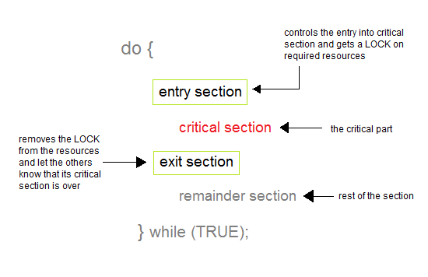
Critical Section problem
Critical Section in OS is a part of the program where shared resources are accessed by the processes.
The Resource may be any resource in a computer like a memory location, Data structure, CPU or any I/O device.
Critical Section Problem arises when multiple processes access the critical section at the same time.
Entry Section-
It acts as a gateway for a process to enter inside the critical section.
It ensures that only one process is present inside the critical section at any time.
It does not allow any other process to enter inside the critical section if one process is already present inside it.

Slide 8
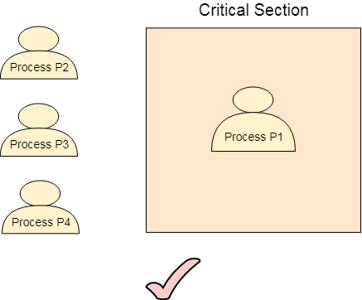
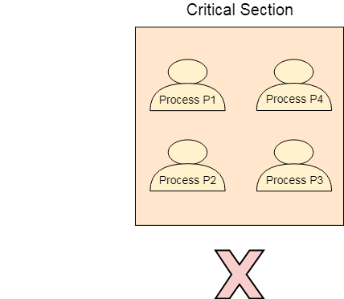
Exit Section-
It acts as an exit gate for a process to leave the critical section.
When a process takes exit from the critical section, some changes are made so that other processes can enter inside the critical section.
Remainder Section: Here Process will be using private resources.
critical section problem should meet the following criteria-
Mutual Exclusion
Our solution must provide mutual exclusion. By Mutual Exclusion, we mean that if one process is executing inside critical section then the other process must not enter in the critical section.

Slide 9
2. Progress
A process can freely enter inside the critical section if there is no other process present inside it.
A process enters the critical section only if it wants to enter.
A process is not forced to enter inside the critical section if it does not want to enter.
3. Bounded Waiting:
The mechanism should ensure-
The wait of a process to enter the critical section is bounded.
A process gets to enter the critical section before its wait gets over.

Slide 10
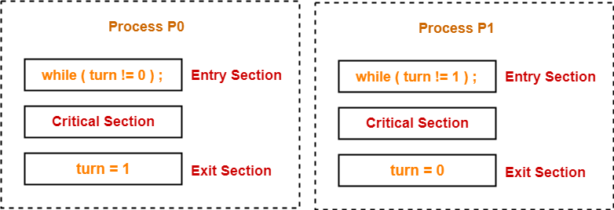
Solutions to Critical section problem
Algo1
Turn Variable-
Turn variable is a Boolean variable is a synchronization mechanism that provides synchronization among two processes
Initially, turn value is set to 0.
turn value = 0 means it is the turn of process P₀ to enter the critical section.
turn value = 1 means it is the turn of process P₁ to enter the critical section.

Slide 11
Working-
This synchronization mechanism works as explained in the following scenes-
Scene-01:
Process P₀ arrives.
It executes the turn!=0 instruction.
Since turn value is set to 0, so it returns value 0 to the while loop.
The while loop condition breaks.
Process P₀ enters the critical section and executes.
Now, even if process P₀ gets preempted in the middle, process P₁ can not enter the critical section.
Process P₁ can not enter unless process P₀ completes and sets the turn value to 1.

Slide 12
Scene-02:
Process P₁ arrives.
It executes the turn!=1 instruction.
Since turn value is set to 0, (turn!=1); means (0!=1);(True) it means .
The process P₁ is trapped inside an infinite while loop.
The while loop keeps the process P₁ busy until the turn value becomes 1 and its condition breaks.
Scene-03:
Process P₀ comes out of the critical section and sets the turn value to 1.
The while loop condition of process P₁ breaks.
Now, the process P₁ waiting for the critical section enters the critical section and execute.
Now, even if process P₁ gets preempted in the middle, process P₀ can not enter the critical section.
Process P₀ can not enter unless process P₁ completes and sets the turn value to 0.

Slide 13
The characteristics of this synchronization mechanism are-
It ensures mutual exclusion.
It follows the strict alternation approach.
Processes have to compulsorily enter the critical section alternately whether they want it or not.
It does not guarantee progress since it follows strict alternation approach.
It ensures bounded waiting since processes are executed turn wise one by one and each process is guaranteed to get a chance.
It ensures processes does not starve for the CPU.

Slide 14
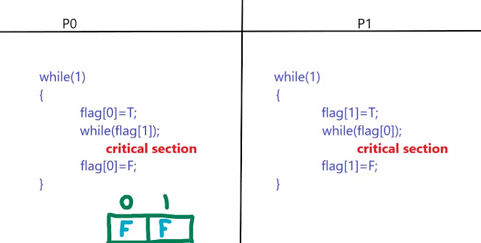
flag Variable-
Flag variable is a synchronization mechanism that provides synchronization among two processes
.
Initially, flag [0] and flag [1] are set to False.
flag value [0] = False means that process P₀ is not interested to enter the critical section.
flag value [0] = True means that process P₀ is interested to enter the critical section.
flag value [1] = False means that process P₁ is not interested to enter the critical section.
flag value [1] = True means that process P₁ is interested to enter the critical section.

Slide 15
Working-
Suppose P0 wants to enter then we will execute its code and flag[0] is turned T. Now the while loop is there to check whether P1 also wants to enter critical section or not. Since value of flag[1]=F so while loop condition is false and P0 will enter critical section.
Now lets check if the above code holds true for Mutual Exclusion or not. Suppose when P0 entered the critical section at that time we context switched to P1 and flag[1]=T. The while loop is executed which says flag[0] should be T and flag[0] is actually T thus P1 will be trapped in the while loop.
Suppose context switch occurs and now we are in P0 again. Now P0 comes out of critical section and flag[0] is set F.
Now P1 can can enter critical section because flag[0] is F and while loop breaks.

Slide 16
Now, let's check if P0 can enter again into critical section or not. flag[0] is set T. Now, while loop will be executed which says if flag[1] is T and flag[1] is actually set to T so P0 will be trapped in the while loop. Therefore, Mutual Exclusion is satisfied here.
Now let's check for Progress. Suppose the flag array is set to F for both slots again.
Now P1 is not interested in entering critical section and P0 wants to enter critical section so flag[0] is set T. Now, while loop is checked which says flag[1] should be T but it is F because P1 is not interested in entering critical section. So, P0 will enter critical section.
Now, let say P0 comes out of Critical section and turns flag[0] to F. now, again P0 wants to enter critical section and it turns flag[0] to T. Again it checks while loop whether flag[1] is T or not but P1 is not interested in entering so P0 will enter critical section again.
So, you can see that only those processes are participating which really wants to enter critical section. So, it should hold true for Progress but it will not.

Slide 17
Suppose the flag array is set to F again. Now , P0 wants to enter critical section so flag[0] is set T.
Here, before executing while loop for P0 we context switched to P1. P1 also wants to enter critical section so flag[1] is also set T.
But now, while loop of P1 which says flag[0] should be T is actually T so P0 will be trapped in while loop. Same goes for while loop for P0 because while of P0 says that flag[1] should be T which is actually T so P0 will also be trapped in while loop. Thus the system goes in deadlock.

Slide 18
Peterson’s Solution
In Peterson’s solution, We are combining both algo1 1 (turn variable)and algo2(flag variable)
boolean flag[i] :Initialized to FALSE, initially no one is interested in entering the critical section
P0 P1
While(1) While(1)
{ {
flag[0]=T flag[1]=T
turn=1 turn=0
While(turn==1 && flag[1]==T); While(turn==0 && flag[0]==T);
Critical section Critical Section
flag[0]=F flag[1]=F
} }

Slide 19
Semaphores
By Petersons algorithm only two process synchronization would possible. In Real n-process will be executing. How to provide synchronization for n-process. The solution is Semaphores.
A Semaphore is an integer variable that apart from initialization it is accessed only through standard atomic operations wait() and signal().
For solving critical section problem using semaphore, the semaphore value should be initialized to 1.
Wait(s) Signal(S)
{ {
while(S<=0); S=S+1
S=S-1: }
}
Wait(s): It will reduce the value by 1
Signal(S): It increases value by 1

Slide 20
Syntax
do
{
Wait(s)
Critical section
Signal(S)
remainder Section
}While(T)
Applications:
Solving n-process critical Section problem
Order of executing among processes
Resource management

Slide 21
Order of Execution:
In a multiprogramming more process are going to be executed
Example P1,P2,P3. Suppose we want P2(radius) to be executed first ,next P1(Area) and P3(cost)
Here we want P2 process to be executed first. Even if OS give charge to p1 and P3 it should not to be executed.
Here we can use semaphores to solve the problem.
In this we are using two semaphore values s1=0,s2=0
Wait(S1) P wait(s2)
P1 signal(s1) P3
Signal(S2)

Slide 22
Resource management
Suppose we have 5 printers and 5 processes
Let initialize semaphore value=5
Pi
{
wait(S)
C.S
Signal(S)
Remainder section
}

Slide 23
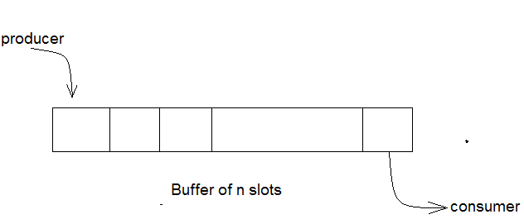
Classical Problems of Synchronization
The Bounded-Buffer Problem
Bounded buffer problem, which is also called producer consumer problem,
There is a buffer of n slots and each slot is capable of storing one unit of data. There are two processes running, namely, producer and consumer, which are operating on the buffer.
A producer tries to insert data into an empty slot of the buffer. A consumer tries to remove data from a filled slot in the buffer.
The semaphore S provides mutual exclusion for accesses to the buffer pool and is initialized to the value 1.
The empty and full semaphores count the number of empty and full buffers, respectively. The semaphore empty is initialized to the value n; the semaphore full is initialized to the value 0.

Slide 24
Producer Consumer
While(T) While(T)
{ {
Producer() Consumer()
wait(E); wait(F);
wait(S); wait(S);
Append() take()
Signal(S) signal(S)
Signal(F) signal(E)
} }

Slide 25
Reader Writer Problem
A file is shared between Reader and Writer process
Reader process can read file,Writer process can both read and write file
Problem: Allow Multiple readers to read the file simultaneously i,e. RR (Read Read)Possible.
When a reader process accessing the file then writer process is not allowed to access file i,e. RW not possible.
When writer process accessing the file, then no other process is allowed to access file. i,e WE,WW not possible.

Slide 26
In order to provide solution to reader writer problem we will use
integer readcount initialized to 0(It informs how many readers are reading file)
Semaphore mutex initialized to1
Semaphore writer initialized to 1
Structure of writer process
While(true)
{
wait(wrt);
// writing is performed
Signal(wrt);
}

Slide 27
Structure of Reader Process.
While(true)
{
wait(mutex);//Reader wants to enter the critical section
readcount++;
if (readcount==1)
wait(wrt);
signal(mutex);
Critical Section //current reader performs reading here
wait(mutex); // a reader wants to leave
readcount--;
if (readcount == 0)
signal(wrt); //writers can enter
signal(mutex); // reader leaves

Slide 28


Slide 29


Slide 30
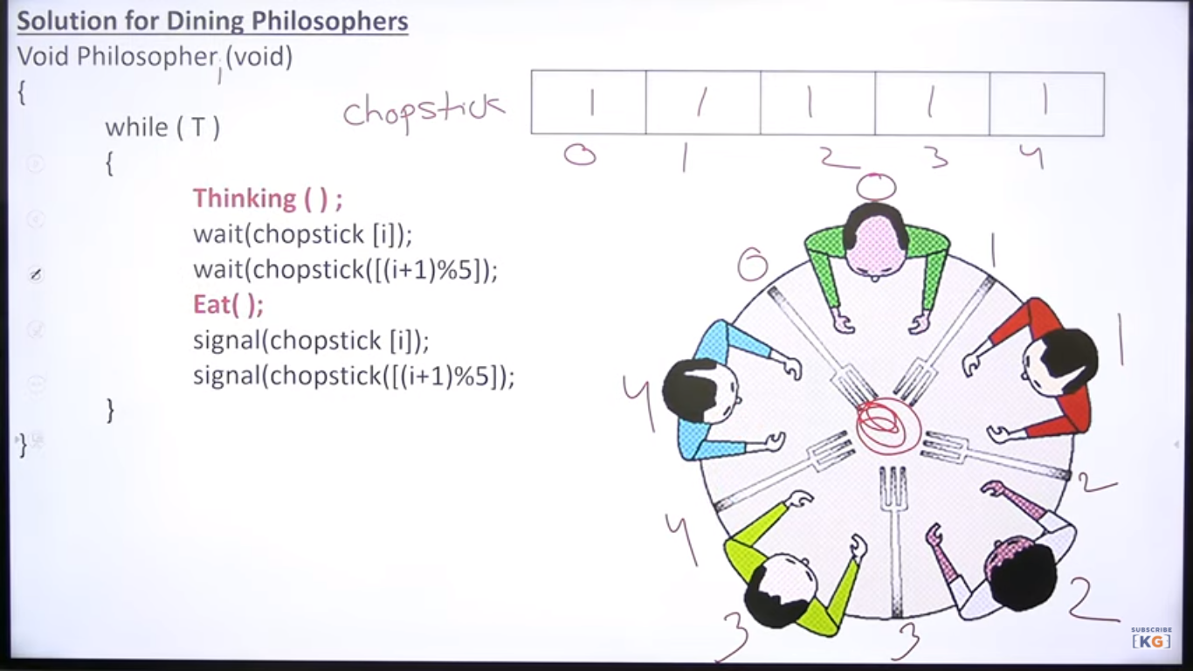

Slide 31
Although this solution guarantees that no two neighbors are eating simultaneously, it must be rejected because it has the possibility of creating a deadlock. Suppose that all five philosophers become hungry simultaneously, and each grabs her left chopstick. All the elements of chopstick will now be equal to 0.
When each philosopher tries to grab her right chopstick, she will be delayed forever.
The Proposed solution for deadlock problem is
Allow at most four philosophers to be sitting simultaneously at the table.
Allow six chopstick to be used simultaneously at the table.
Allow a philosopher to pick up her chopsticks are available
Use an asymmetric solution; that is, an odd philosopher picks up first her left chopstick and then her right chopstick, whereas an even philosopher picks up her right chopstick and then her left chopstick.

